Slide 1
Classification Metrics
© DataMites® and Skillogic® are part of Skillfloor Solutions Private Limited. All rights reserved

Slide 2
Measuring the quality of classification
Metrics for a classification task focus on the quality of predictions with the target as categorical or discrete in nature.
Key parameters of interest are as follows:
Confusion Matrix
Accuracy Score
Recall Score
Precision Score
F1 Score
AUC ROC Curve

Slide 3
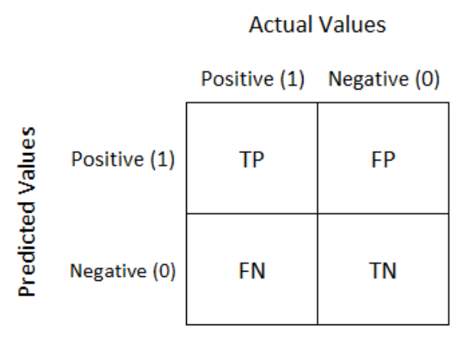
Confusion Matrix - Binary classification
Confusion matrix is typically a 2 by 2 table to enumerate the performance of a model.
A comparison of model predicted values of the target and actual labels or ground truth values known from the data.

Slide 4
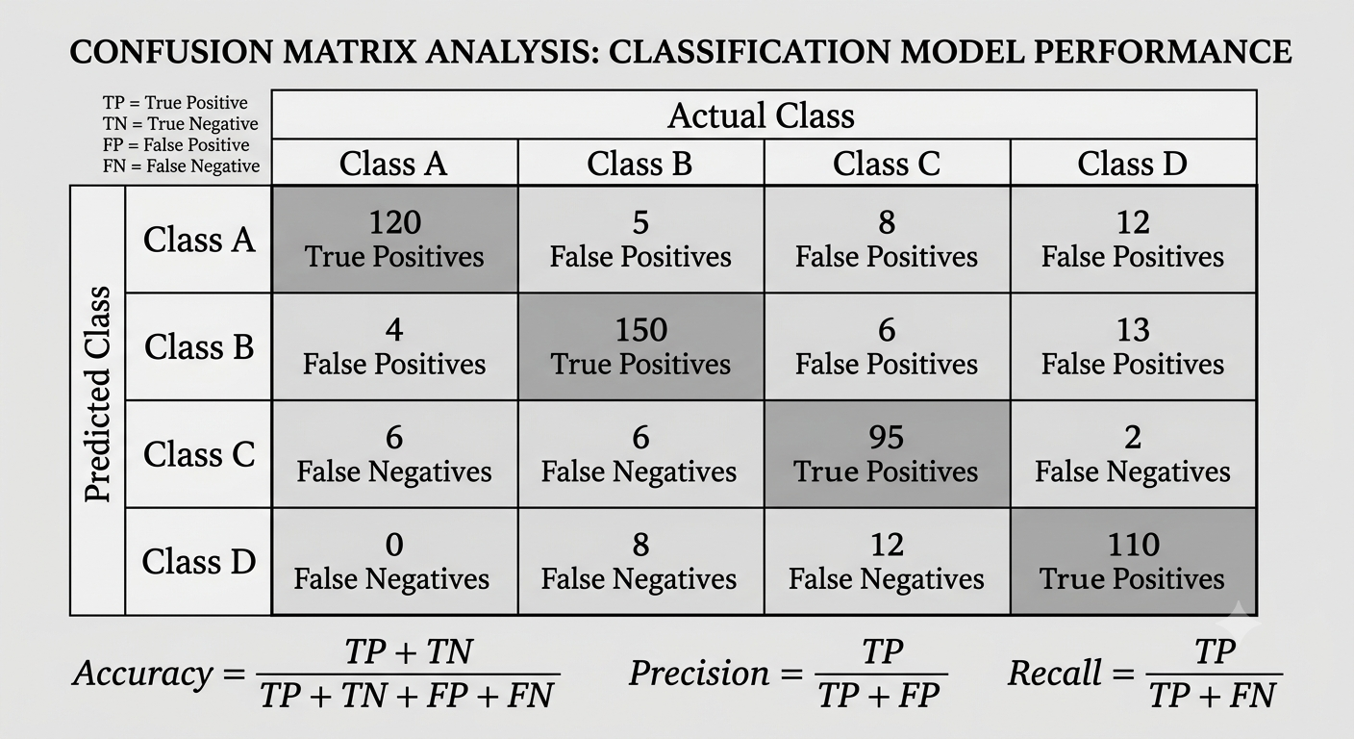
Confusion Matrix - Multiclass

Slide 5
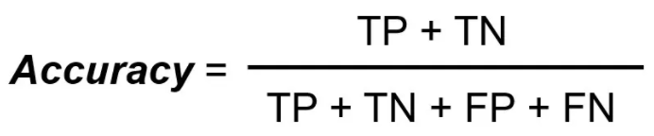
Accuracy Score
Accuracy Score simply measures how often the classifier has predicted correctly.
We can define accuracy as the ratio of the number of correct predictions to the total number of predictions.

Slide 6
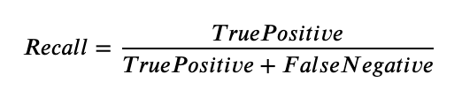
Recall Score
Recall focuses on minimising False Negatives.
The question to be answered: Out of all positively labelled datapoints, how many did the model predict correctly?

Slide 7
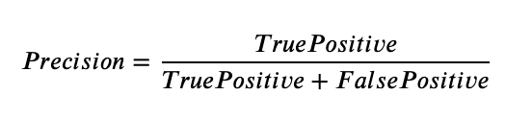
Precision Score
Precision Score focuses on minimising False Positives.
The question to be answered: Out of all datapoints predicted as positive, how many are correct?

Slide 8

F1 Score
When both potential errors (FP and FN) deserve equal attention, the F1 Score can be utilised.
It is given by the harmonic mean of precision and recall.

Slide 9
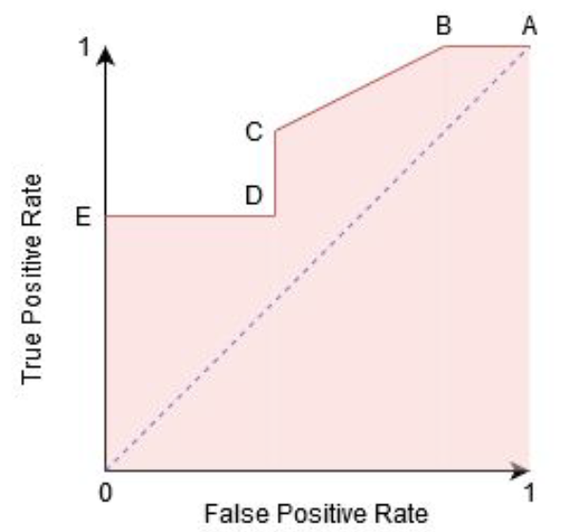
AUC ROC Curve
AUC ROC stands for Area under curve Receiver Operating Characteristic.
A probability curve that plots true positive rate against the false positive rate at various thresholds.
A model with a higher area under curve represents better balance in its performance.

Slide 10
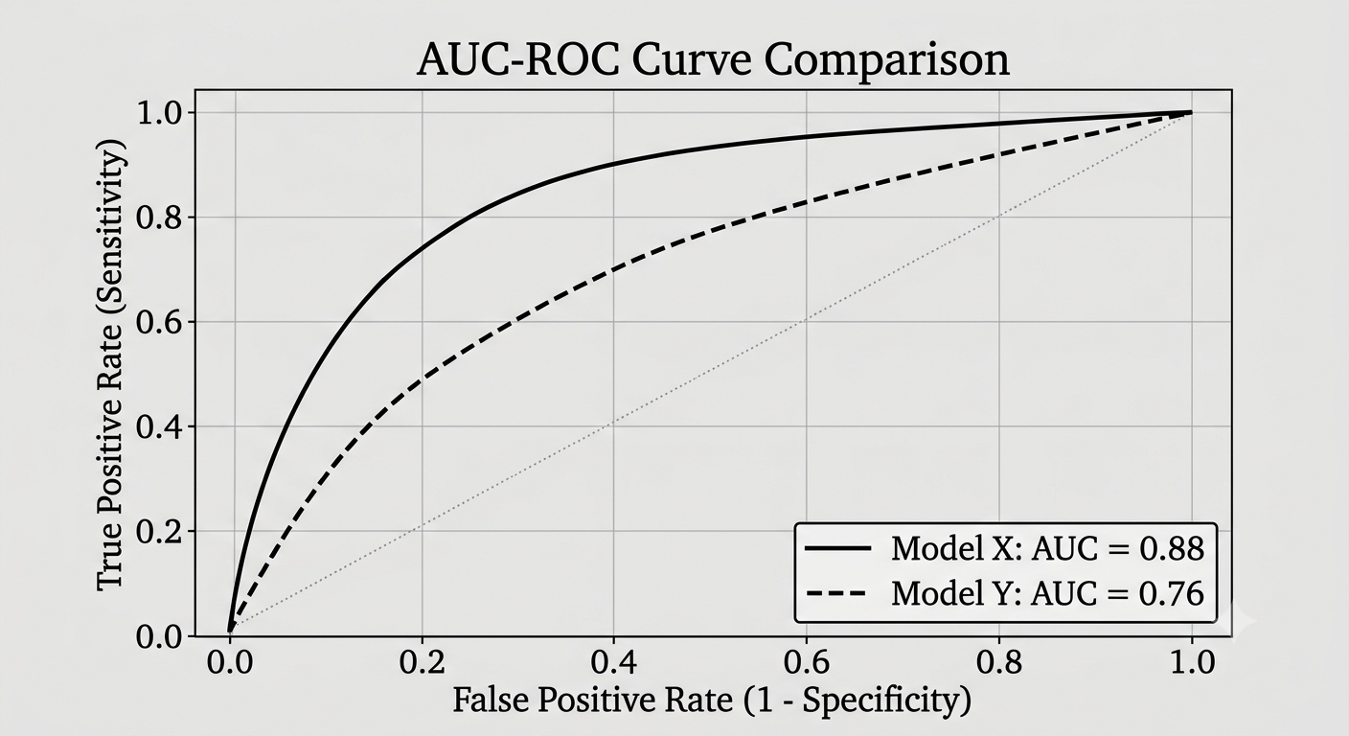
AUC ROC Curve
A model with a higher area under curve represents better balance in its performance.

Slide 11
Questions?
Q&A Session

